Slide 1
EETS 8332: Advanced Network Design
M. Scott Kingsley
Dynamic Multipoint VPN (DMVPN)

Slide 2
Dynamic Multipoint VPN (DMVPN)
What is DMVPN?
DMVPN is a solution for building VPNs in an easy, dynamic and scalable manner
Uses standard technologies
GRE Tunnel Encapsulation
Next Hop Resolution Protocol (NHRP)
IPsec for encryption of the tunnel and authentication

Slide 3
Dynamic Multipoint VPN (DMVPN)
Basic features
Layering model to support separation of forwarding, tunneling and encryption
Distributed system for scalability
Redundancy and load balancing

Slide 4
Dynamic Multipoint VPN (DMVPN)
GRE and NHRP used for tunneling
Both IPv4/IPv6 passenger data over either IPv4 or IPv6 transport.
Can easily be extended for other passenger protocols.
No change needed to IPsec.
Single tunnel between peers supports any number of data flows.
Reduces the number of IPsec SAs.

Slide 5
Dynamic Multipoint VPN (DMVPN)
Reduces the effectiveness of outsiders doing traffic analysis.
Easy setup and use of multiple tunnels between peers.
Redundancy and/or load-balancing of data flows.
No issue with IPsec SA’s trying to encrypt same flows to different peers.
NHRP mapping database is naturally distributed across network.
No single point of failure or congestion.
Provides for easy scaling.

Slide 6
Dynamic Multipoint VPN (DMVPN)
Standard IP Routing over DMVPN
Dynamically learn destinations automatically.
Changes or movement of hosts/subnets/nodes automatically propagated throughout network.
Handles millions of routes.
Standard tools to control routing advertisements.
Optional tools can be layered on top for more sophisticated forwarding control.

Slide 7
Dynamic Multipoint VPN (DMVPN)
IPsec used for Encryption
Encrypt the tunnel not the data flows.
Can add/remove data flows.
No change to IPsec.
Can add new passenger protocols.
Layering also makes it easier to add in new encryption protocols such as IKEv2.

Slide 8
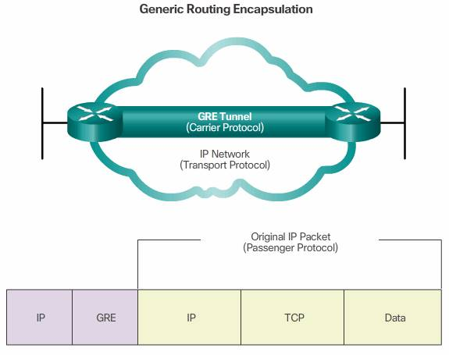
Dynamic Multipoint VPN (DMVPN)

Slide 9
Dynamic Multipoint VPN (DMVPN)
How it works
Spokes build a dynamic permanent GRE/IPsec tunnel to the hub, but not to other spokes. Spokes register as NHRP clients of the NHRP hub.
When a spoke needs to send packets to a destination (private) subnet behind other spokes, they send packets via the hub path.
Hubs sends NHRP redirect message to spokes to trigger spokes to build direct path.

Slide 10
Dynamic Multipoint VPN (DMVPN)
Spokes send NHRP query via the hub path to get the real (outside) address of the remote spoke.
Spokes can then initiate a dynamic GRE/IPsec tunnel to the remote spoke (because it knows the peer address).

Slide 11
Dynamic Multipoint VPN (DMVPN)
A new spoke in a DMVPN does not require changes on a hub to which it is connected other than authentication and authorization state which are dynamically handled.
NHRP is used to distribute IP addresses. These mappings will be redistributed or rediscovered upon any address change.
Requires minimal configuration in order to configure protocols running over IPsec tunnels.

Slide 12
Dynamic Multipoint VPN (DMVPN)
Spokes can talk directly to each other if and only if the hub and spoke policies allow it.
DMVPN peers have unique authentication credentials and uses them for each peer connection.
DMVPN supports star, full mesh, or a partial mesh topologies. The protocol stack can be applied to all known scenarios.

Slide 13
Dynamic Multipoint VPN (DMVPN)
DMVPN allows monitoring and logging.
L3VPNs are supported over IPsec/GRE tunnels.
DMVPN allows multiple resiliency mechanisms and no device, spoke or hub, is a single point of failure.

Slide 14
Dynamic Multipoint VPN (DMVPN) Summary
Works with different types of spokes
Spokes with complex private networks.
PC Client with no private network.
Architecture and building blocks already exist,

Slide 15
Dynamic Multipoint VPN (DMVPN) Summary
Functional separation
Peer discovery
Tunneling
Authentication and authorization
Packet protection
Uses existing IETF RFCs
NHRP: RFC2332
GRE: RFC1701
PKIX/IKE: RFC5280/RFC5998
IPsec: RFC4301

Slide 16
Dynamic Multipoint VPN DEEP DIVE
There are four parts to the DMVPN:
Multipoint GRE (mGRE)
NHRP (Next Hop Resolution Protocol)
Routing (RIP, EIGRP, OSPF, BGP, etc.)
IPsec (not required but recommended)

Slide 17
Multipoint GRE
GRE tunnels are point-to-point and don’t scale well.
For example, let’s say we have a company network with some sites that we want to connect to each other using regular Internet connections:

Slide 18
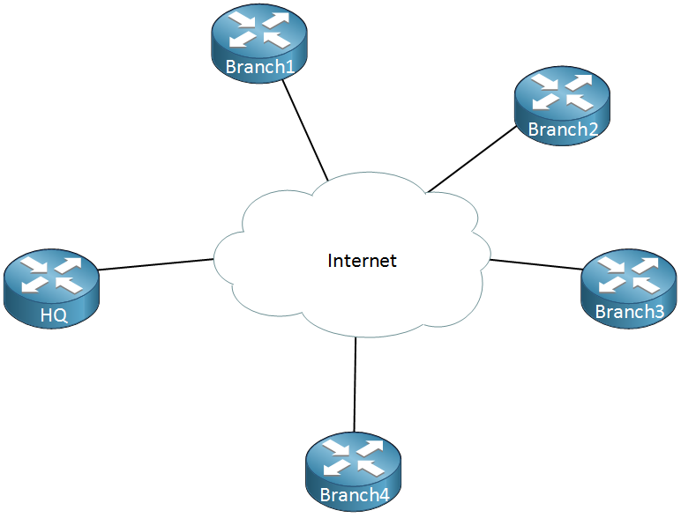
Multipoint GRE

Slide 19
Multipoint GRE
Above we have one router that represents the HQ and there are four branch offices. Let’s say that we have the following requirements:
Each branch office has to be connected to the HQ.
Traffic between Branch 1 and Branch 2 has to be tunneled directly.
Traffic between Branch 3 and Branch 4 has to be tunneled directly.
To accomplish this we will have to configure a bunch of GRE tunnels which will look like this:

Slide 20
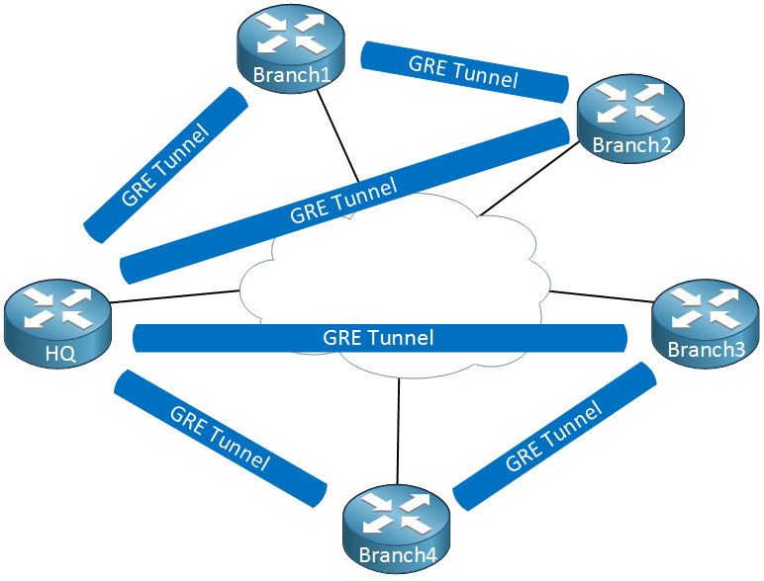
Multipoint GRE

Slide 21
Multipoint GRE
This will get messy quickly.
we have to create multiple tunnel interfaces, set the source/destination IP addresses etc.
It will work but it’s not a very scalable solution.
Multipoint GRE, as the name implies allows us to have multiple destinations.
When we use them, our picture could look like this:

Slide 22
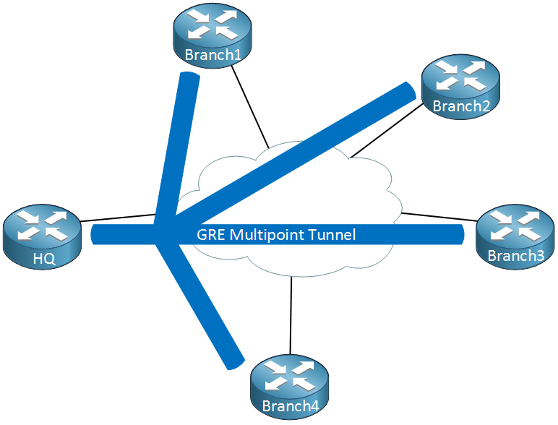
Multipoint GRE

Slide 23
Multipoint GRE
When we use GRE Multipoint, there will be only one tunnel interface on each router.
The HQ for example has one tunnel with each branch office as its destination.
Now you might be wondering, what about the requirement where branch office 1/2 and branch office 3/4 have a direct tunnel?
Right now we have a hub and spoke topology. The cool thing about DMVPN is that we use multipoint GRE so we can have multiple destinations.
When we need to tunnel something between branch office 1/2 or 3/4, we automatically “build” new tunnels:

Slide 24
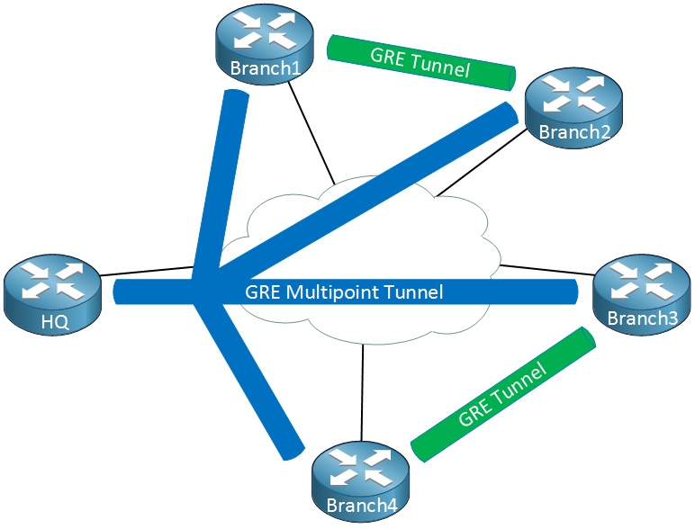
Multipoint GRE

Slide 25
Multipoint GRE
When there is traffic between the branch offices, we can tunnel it directly instead of sending it through the HQ router. This sounds pretty cool but it introduces some problems…

Slide 26
Multipoint GRE
When we configure point-to-point GRE tunnels we have to configure a source and destination IP address that are used to build the GRE tunnel.
When two branch routers want to tunnel some traffic, how do they know what IP addresses to use?

Slide 27
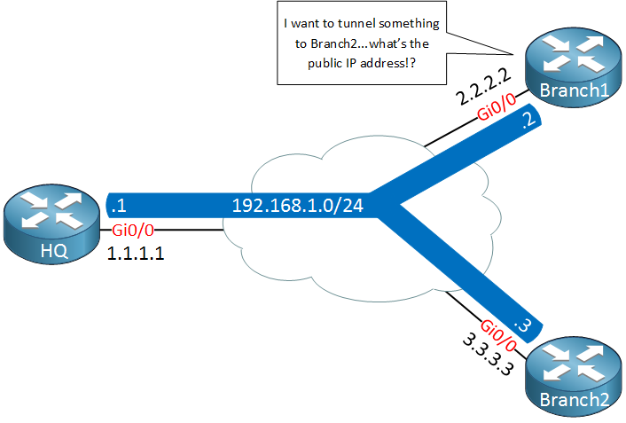
Multipoint GRE

Slide 28
Multipoint GRE
Above we have our HQ and two branch routers, branch1 and branch2. Each router is connected to the Internet and has a public IP address:
HQ: 1.1.1.1
Branch 1: 2.2.2.2
Branch 2: 3.3.3.3

Slide 29
Multipoint GRE
On the GRE multipoint tunnel interface we use a single subnet with the following private IP addresses:
HQ: 192.168.1.1
Branch1: 192.168.1.2
Branch2: 192.168.1.3
Let’s say that we want to send a ping from branch1’s tunnel interface to the tunnel interface of branch 2. Here’s what the GRE encapsulated IP packet will look like:

Slide 30
Multipoint GRE
Let’s say that we want to send a ping from branch1’s tunnel interface to the tunnel interface of branch2. Here’s what the GRE encapsulated IP packet will look like:

Slide 31
Multipoint GRE
The “inner” source and destination IP addresses are known to us, these are the IP address of the tunnel interfaces.
We encapsulate this IP packet, put a GRE header in front of it and then we have to fill in the “outer” source and destination IP addresses so that this packet can be routed on the Internet.
The branch 1 router knows it’s own public IP address but it has no clue what the public IP address of branch2 is.
To fix this problem, we need some help from another protocol.

Slide 32
Multipoint GRE
In NHRP terminology , you’ll see that we don’t talk about “public IP addresses” but NBMA addresses. NHRP is an old protocol (the RFC is from 1998) which was originally developed for NBMA networks like frame-relay or ATM.
NHRP is a bit similar to ARP or frame-relay inverse ARP. Instead of mapping L2 to L3 information, we are now mapping a tunnel IP address to a NBMA IP address.

Slide 33
Next Hop Resolution Protocol (NHRP)
We need something that helps our branch 1 router figure out what the public IP address is of the branch 2 router, we do this with a protocol called NHRP (Next Hop Resolution Protocol). Here’s an explanation of how NHRP works:

Slide 34
Next Hop Resolution Protocol (NHRP)
One router will be the NHRP server.
All other routers will be NHRP clients.
NHRP clients register themselves with the NHRP server and report their public IP address.
The NHRP server keeps track of all public IP addresses in its cache.
When one router wants to tunnel something to another router, it will request the NHRP server for the public IP address of the other router.

Slide 35
Next Hop Resolution Protocol (NHRP)
Since NHRP uses this server and clients model, it makes sense to use a hub and spoke topology for multipoint GRE.
Our hub router will be the NHRP server and all other routers will be the spokes.

Slide 36
Next Hop Resolution Protocol (NHRP)
Below we have two spoke routers (NHRP clients) which establish a tunnel to the hub router.
The destination IP address of the hub router will be statically configured on the spoke routers.
The hub router will dynamically accept spoke routers.
The routers will use a NHRP registration request message to register their public IP addresses to the hub.
The hub, our NHRP server will create a mapping between the public IP addresses and the IP addresses of the tunnel interfaces.

Slide 37
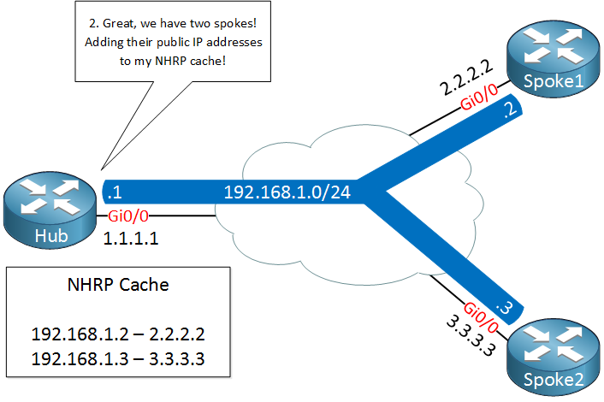
Next Hop Resolution Protocol (NHRP)

Slide 38
Next Hop Resolution Protocol (NHRP)
A few seconds later, spoke1 decides that it wants to send something to spoke2.
It needs to figure out the destination public IP address of spoke2 so it will send a NHRP resolution request, asking the hub router what the public IP address of spoke2 is.

Slide 39
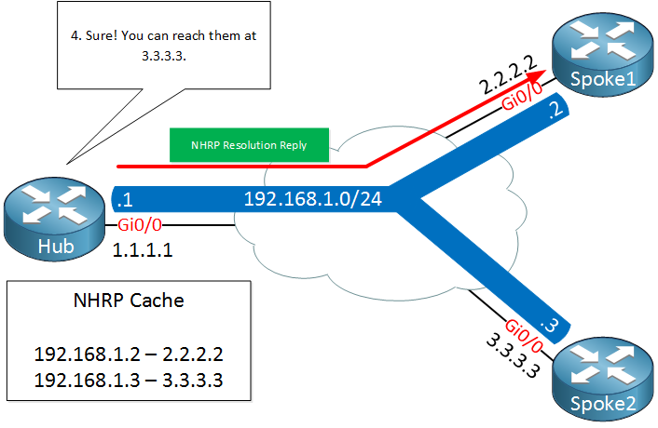
Next Hop Resolution Protocol (NHRP)

Slide 40
Next Hop Resolution Protocol (NHRP)
The hub router checks its cache, finds an entry for spoke2 and sends the NHRP resolution reply to spoke1 with the public IP address of spoke2.

Slide 41
Next Hop Resolution Protocol (NHRP)

Slide 42
Next Hop Resolution Protocol (NHRP)
Spoke1 now knows the destination public IP address of spoke2 and is able to tunnel something directly.
This is great, we only required the hub to figure out what the public IP address is and all traffic can be sent from spoke to spoke directly.

Slide 43
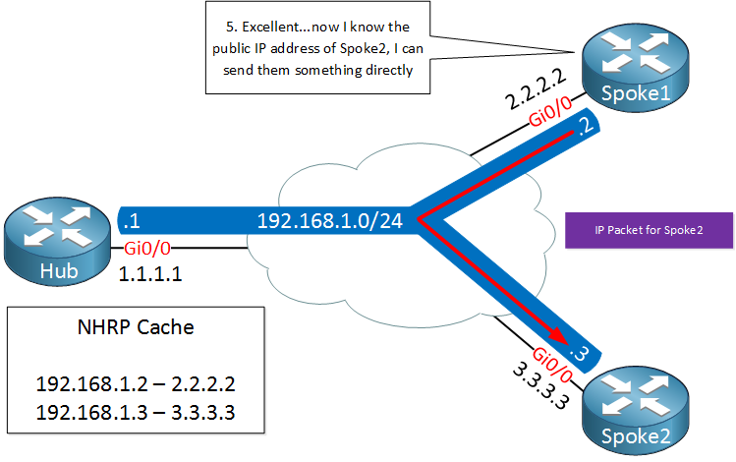
Next Hop Resolution Protocol (NHRP)

Slide 44
Next Hop Resolution Protocol (NHRP)
DMVPN has different versions which we call phases, there’s three of them:
Phase 1
Phase 2
Phase 3

Slide 45
Next Hop Resolution Protocol (NHRP)
Phase 1
DMVPN phase 1 only provides hub-and-spoke tunnel deployment.
This means GRE tunnels are only built between the hub and the spokes.
Traffic destined to networks behind spokes is forced to first traverse the hub.

Slide 46
Next Hop Resolution Protocol (NHRP)
Phase 2
In Phase 1, traffic between the spokes would always hit the hub. This was a shortcoming of DMVPN as, in a larger deployment, the hub would always have to be burdened with encapsulate/de-capsulate overhead for the spoke-to-spoke traffic.
In addition to increased routing overhead on the hub, spoke-to-spoke traffic would take a suboptimal path by detouring to the hub and then reaching the remote spoke.
Phase 2 improved on Phase 1 by allowing spokes to build a spoke-to-spoke tunnels.

Slide 47
Next Hop Resolution Protocol (NHRP)
Phase 3
Though DMVPN Phase 2 deployment provided direct spoke-to-spoke tunnels, one of the limitations is maintaining full routing tables on the spokes.
Each route for remote spoke networks needs to be a specific route with the next hop pointing to the remote spoke’s tunnel address.
This prevents the hub from being able to send down a summarized route to the spokes for a more concise routing table.

Slide 48
Next Hop Resolution Protocol (NHRP)
Phase 3 overcomes this restriction using NHRP traffic indication messages from the hub to signal to the spokes that a better path exists to reach the target network.

Slide 49
DMVPN versus MPLS
DMVPN over Internet
MPLS over provider private IP network
MPLS cost
MPLS reliability and QoS
DMVPN often used as backup for MPLS
DMVPN encryption

Slide 50
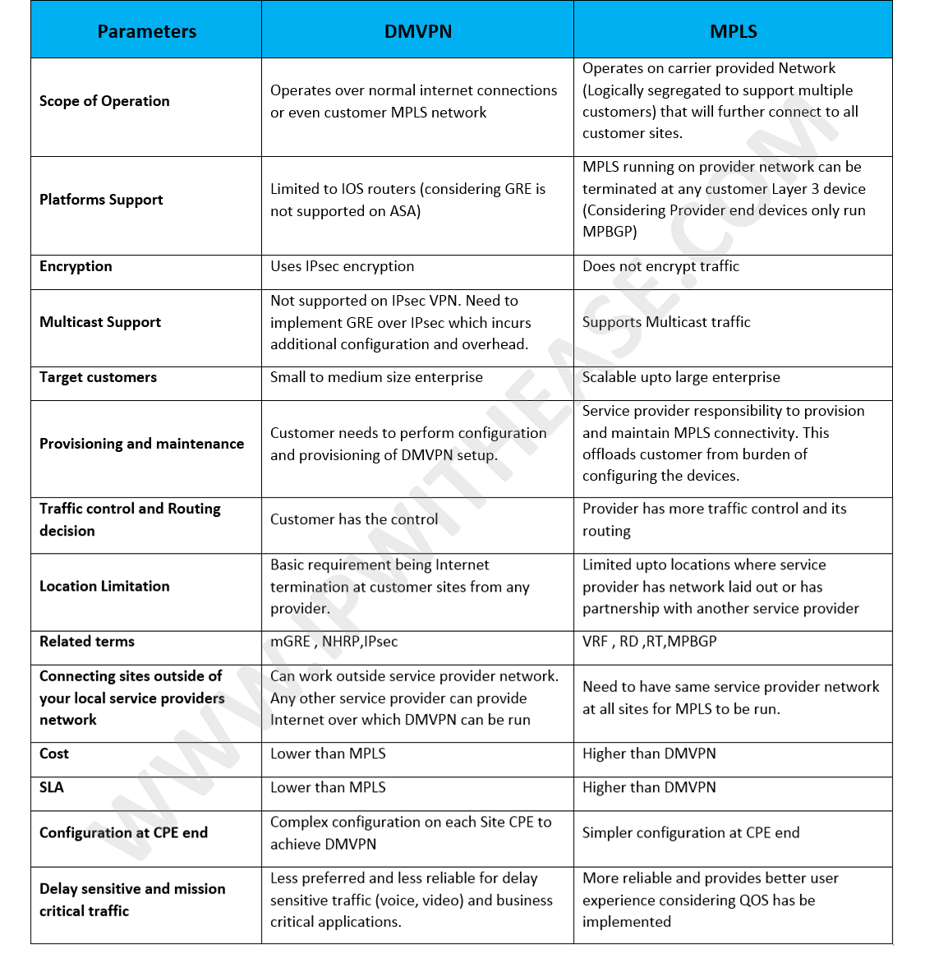
DMVPN versus MPLS

Slide 51
CISCO VPN COMPARISON

